Slide 1
Introduction to Kubernetes
A modern Distributed os

Slide 2
Docker Recap
Linux containers
Docker API
Images
Containers
Registry

Slide 3
Docker Recap
Containers run on single Docker host
Containers are ephemeral
Nothing watchdogs the containers
Containers can have external persistence

Slide 4
Why Docker Matters
Brings Agility
Dependency management in DockerFiles
Application density per Host
Reduced management overhead in terms of VMs
On premise, hybrid, public cloud

Slide 5
Why you Win with Docker-Based Solutions
Immutable infrastructure
DevOps
CI/CD

Slide 6

Enter Kubernetes
Kubernetes is an open-source system for automating deployment, scaling, and management of containerized applications.

Slide 7
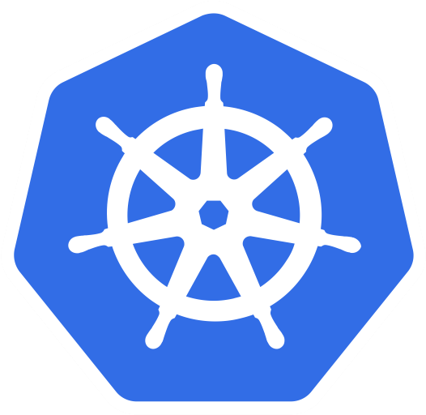
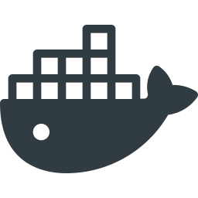
Simple Kubernetes Architecture
Docker Host
Docker Host
Docker Host
Kubernetes
Host

Slide 8
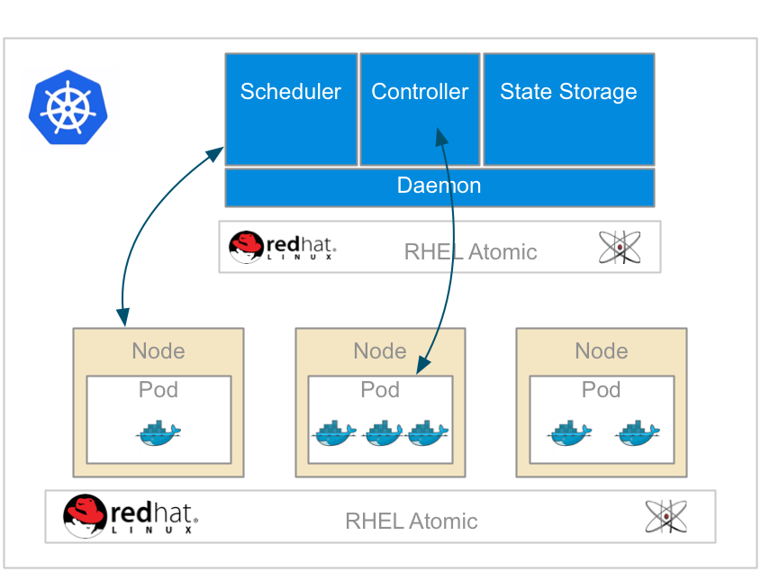
Overall Kubernetes

Slide 9
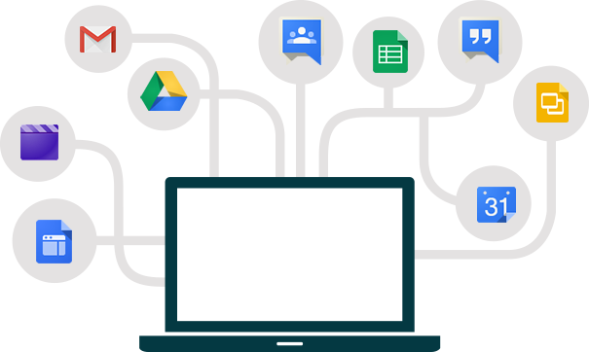

Containerize all the Things
Everything at Google runs in containers!
Everything means, Gmail, search, Google Maps
With over 2 billion containers a week
And of course, Google Cloud Services

Slide 10
What is a Kubernetes?
“Helmsman of a Ship”
Containers at Google
Large-scale cluster management at Google with Borg
Open source 6/2014
GKE…
Red Hat - a top contributor
Written in golang completely
Do we need this?

Slide 11
Kubernetes Components
Different way to look at managing instances and scaling
Design for failure
Efficient / Lean/ Simple
Portability
Extensible
How to place containers on a cluster
Smart placement
How to interact with a system that does placement

Slide 12
What Does Kubernetes Do?
Different than configuration management
Immutable infrastructure principles
What to do when containers fail?
Containers will fail
Cluster security
Scaling

Slide 13
Why is it Important
Managing containers by hand is harder than VMs: It won’t scale
Automate the boilerplate stuff
Runbooks → Scripts → Config management → Scale
Decouple application from machine
Applications run on resources
Kubernetes manages this interaction of applications and resources

Slide 14
Kubernetes Core Concepts
Simplicity, Simplicity, Simplicity
Pods
Labels / Selectors
Replication Controllers
Services
See the API at http://kubernetes.io/third_party/swagger-ui/
Node
Pod 1
Pod 2
Container
Container

Slide 15
Reconciliation of End State
Cluster
Declare
Make it

Slide 16
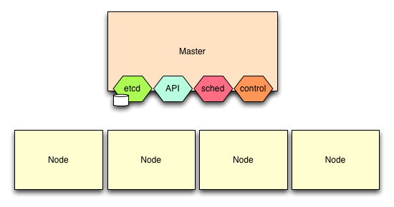
Kubernetes Control Plane
Controller manager
etcd
API Server
Scheduler
Notes:
etcd
API Server
Scheduler
Controller manager

Slide 17
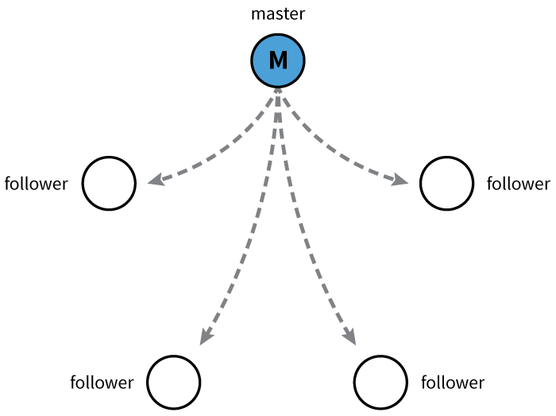
etcd
Open source project started at CoreOS
Distributed database
Raft algorithm/protocol
Watchable
etcd provides data store

Slide 18
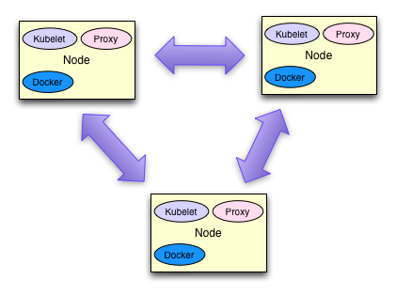
Kubernetes Nodes
Nodes are VMs or physical hosts
Nodes need connectivity between them
Ideally same network, data center, and availability zone
It can run on multiple zones in same region https://kubernetes.io/docs/admin/multiple-zones/

Slide 19
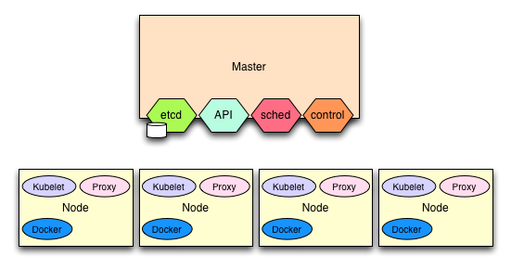
Kubernetes Nodes

Slide 20
Kubernetes Nodes
Kubelet
Watches for pods to be assigned to node
Mount volumes
Install secrets
Runs the pod (via Docker)
Reports pod status / node status
Kube-Proxy
Connection forwarding
Kube services
Docker

Slide 21
Cluster Add-Ons
Monitoring
DNS
UI
Logging

Slide 22
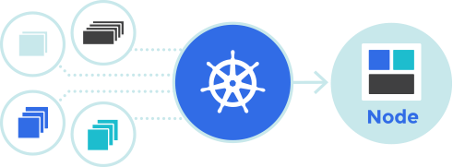
Set up Kubernetes
Lab prerequisites in place – if any
Verify you have most recent version of Oracle‘s VirtualBox
Install Kubernetes
Understand the architecture
Smoke test

Slide 23
Kubernetes Deep Dive
let’s dive deeper now that we know that basics

Slide 24
Kubernetes Core Concepts
Pods
Labels/Selectors
Replication Controllers
Services

Slide 25
Kubernetes Pods
A pod is one or more Docker containers
Ensures colocation and shared fate
Pods are scheduled and do not move nodes
Docker containers share resources within the pod
Volumes
Network / IP
Port space
CPU / Mem allocations
Pod health probes
Readiness
Liveness

Slide 26
Kubernetes Pods
Container
“foo”
Container
“bar”
app=foo-app
env=prod
version-1.0
Area
Namespaces:
Net
IPC
etc.
Volume
Volume
Volume

Slide 27
Kubernetes Pods
Kubernetes Scheduler reads from etcd
Each node is scheduled by the Scheduler
etcd
Kubernetes Scheduler
Pod
Object
Kubernetes REST API
json
or
yaml
node
node
node
node

Slide 28
Your First Pod
apiVersion: v1
kind: Pod
metadata:
labels:
name: influxdb
name: influxdb
spec:
containers:
- image: docker.io/tutum/influxdb:latest
name: influxdb
ports:
- containerPort: 8083
name: admin
protocol: TCP
- containerPort: 8086
name: http
protocol: TCP
Notes:
Let’s take a look at the Kubernetes resource file that we will use and evolve for the purposes of this first hands-on experience.

Slide 29
Deploy the influxdb Pod
You can either copy/paste locally, or download the pod resource file like this:
curl -s -L https://raw.githubusercontent.com/christian-posta/docker-kubernetes-workshop/master/demos/hands-on-pods/influxdb-simple.yaml -O influxdb-simple.yaml
Once you have the file locally downloaded, run the kubectl command (./cluster/kubectl.sh) like this:
kubectl create -f influxdb-simple.yaml

Slide 30
Deploy the influxdb Pod
Wait for the Docker image to download and the pod to start.
We can watch the process, like this:
kubectl get pod --watch
And watch the Docker events in another window, like this:
NOTE: You’ll need to be logged into minion-1 directly to see the Docker events:
docker events

Slide 31
Interact with Your First Kubernetes Pod
Let’s begin interacting by using our describe command, like this:
kubectl describe pod/influxdb
Notes:
Now that we have our first pod up, let’s see where it’s deployed. Note where it’s deployed (Node field).

Slide 32
Interact with Your First Kubernetes Pod
kubectl describe pod/influxdb
Output:
Name: influxdb
Namespace: demo-pods
Image(s): docker.io/tutum/influxdb:latest
Node: 10.245.1.3/10.245.1.3
Labels: name=influxdb
Status: Running
Reason:
Message:
IP: 10.246.1.7
Replication Controllers: <none>
Containers:
influxdb:
Image: docker.io/tutum/influxdb:latest
State: Running
Started: Sun, 18 Oct 2015 17:09:16 -0700
Ready: True
Restart Count: 0
Conditions:
Type Status
Ready True
Events:
<truncated>
Notes:
Now that we have our first pod up, let’s see where it’s deployed. Note where it’s deployed (Node field).

Slide 33
Interact with Your First Kubernetes Pod
Now, let’s try to ping:
Output:
ping 10.246.1.7
PING 10.246.1.7 (10.246.1.7) 56(84) bytes of data.
64 bytes from 10.246.1.7: icmp_seq=1 ttl=63 time=2.43 ms
64 bytes from 10.246.1.7: icmp_seq=2 ttl=63 time=8.41 ms
64 bytes from 10.246.1.7: icmp_seq=3 ttl=63 time=1.27 ms
64 bytes from 10.246.1.7: icmp_seq=4 ttl=63 time=2.23 ms
^C
--- 10.246.1.7 ping statistics ---
4 packets transmitted, 4 received, 0% packet loss, time 3004ms
rtt min/avg/max/mdev = 1.271/3.587/8.411/2.819 ms
Notes:
Let’s login to our minion-1 machine and interact with the pod. We found out which machine the pod was running on in the last slide.
vagrant ssh minion-1
Let’s try ping the pod to see if we can reach it from the minion (we could have also logged into the master and run the same commands; the assumption Kubernetes makes is a flat network reachable from anywhere in the cluster. More on the Kubrentes network model later.

Slide 34
Interact with Your First Kubernetes Pod
Now, let’s issue a command to that IP address.
These commands must be run from either master or minion1:
export INFLUX_NODE=10.246.1.7
curl -G "http://$INFLUX_NODE:8086/query" --data-urlencode "q=CREATE DATABASE kubernetes"
curl -X POST "http://$INFLUX_NODE:8086/write?db=kubernetes" -d 'pod,host=node0 count=10'
curl -G "http://$INFLUX_NODE:8086/query?pretty=true" --data-urlencode "db=kubernetes" --data-urlencode "q=SELECT SUM(count) FROM pod"
Notes:
We add a new database to the influxdb index, then we add some data, and finally we query it. You should see 10 as the result.

Slide 35
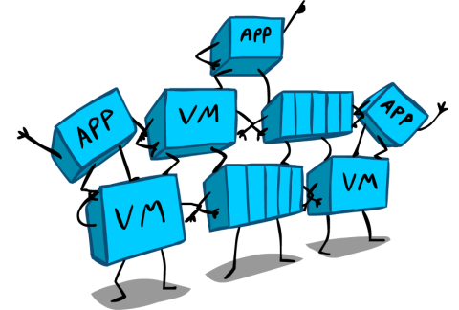
Stateful Containers
emtpyDir
hostpath
gcePersistentDisk
awsElasticBlockStorage
nfs
glusterfs
gitRepo
Notes:
Whenever we add new databases to our influxdb and then stop the pod, we find that the data in the influxdb is not persisted.
Let’s add a way to persist that information. Kubernetes offers a few persistence mechanisms out of the box.

Slide 36
Pods in Production
Uses PersistentVolumes for stateful pods/containers
Uses Kubernetes secrets to distribute credentials
Leverages readiness and liveness probes
Consider resources (CPU/Mem) limits and quotas

Slide 37
Grouping
Organizing your cluster

Slide 38
Grouping
Decouple application dimensions from infrastructure deployments
Tiers
Release Tracks
Grouping of micro services
Kubernetes clusters are dynamic
Predicated on failure
Need a way to identify groups of services
Be able to add/remove from group on failures
Query-able
Kubernetes Labels

Slide 39
What are Kubernetes Labels?
Arbitrary metadata
Attach to any API object
eg, Pods, ReplicationControllers, Endpoints, etc
Simple Key = Value Assignments
Can be queried with selectors

Slide 40
Label Examples
Release = Stable, Release = Canary
Environment = Dev, Environment = Qa, Environment = Prod
Tier = Frontend, Tier = Backend, Tier = Middleware
Partition = Customer A, Partition = Customer B, Etc.
Used to group “like” objects — no expectation of uniqueness

Slide 41
Keys and Values
The structure of a key:
<prefix>/<name>
example key org.apache.hadoop/partition
Prefix can be up to 253 characters
Name can be up to 63 characters
Values can be ([a-z0-9A-Z]) with dashes (-), underscores (_), dots (.)
Values can be up to 63 characters

Slide 42
Example Labels
version=1.0
com.foo/tier=frontend
version=1.0
com.foo/tier=frontend
version=1.1
com.foo/tier=frontend
node.js/app
node.js/app
node.js/app
environment=pre-pred
com.foo/tier=middleware
environment=pre-pred
com.foo/tier=middleware
jboss fuse
jboss fuse
environment=pre-pred
com.foo/tier=db
environment=pre-pred
com.foo/tier=db
environment=pre-pred
com.foo/tier=db
cassandra
cassandra
cassandra

Slide 43
Selectors for Grouping
Labels are query-able metadata
Selectors can do the queries
Equality based
Environment = Production
Tier != Frontend
Combinations: "tier != frontend, version = 1.0.0"
Set based
Environment in (production, pre-production)
Tier notin (frontend, backend)
Partition

Slide 44
Example Selectors
version = 1.1
version=1.0
com.foo/tier=frontend
version=1.0
com.foo/tier=frontend
version=1.1
com.foo/tier=frontend
node.js/app
node.js/app
node.js/app
environment=pre-pred
com.foo/tier=middleware
environment=pre-pred
com.foo/tier=middleware
Environment in Pre-Prod
jboss fuse
jboss fuse
environment=pre-pred
com.foo/tier=db
environment=pre-pred
com.foo/tier=db
environment=pre-pred
com.foo/tier=db
com.foo/tier = db
cassandra
cassandra
cassandra

Slide 45
Annotations
Attaching useful metadata to objects - not query-able
Data that you want to know to build context - easy to have it close
Author information
Build date/timestamp
Links to SCM
PR numbers/Gerrit patch sets
Annotations are not query-able
Can build up tooling around annotations

Slide 46
Scaling and Ensuring Cluster Invariants

Slide 47
Replication Controllers
Cluster
Declare
Make it

Slide 48
Replication Controllers
Can configure the number of replicas of a pod
Will be scheduled across applicable nodes
Replication controllers can change replica value to scale up/down
Which pods are scaled depends on RC selector
Labels and selectors are the backbone of grouping

Slide 49
Replication Controllers
Can even do complicated things with labels/RCs
Take a pod out of cluster by changing its label
Can have multiple RCs so no SPOF
If a pod is unhealthy
RC can kill and restart

Slide 50
Replication Controller
apiVersion: v1
kind: ReplicationController
metadata:
labels:
app: inspector
track: stable
name: inspector
spec:
replicas: 1
selector:
app: inspector
track: stable
template:
metadata:
labels:
app: inspector
track: stable
...
...
spec:
containers:
- image: b.gcr.io/kuar/inspector:1.0.0
imagePullPolicy: IfNotPresent
name: inspector
resources: {}
terminationMessagePath: /dev/termination-log
dnsPolicy: ClusterFirst
restartPolicy: Always
status:
observedGeneration: 1
replicas: 1

Slide 51
Replication Controller
curl -s -L https://raw.githubusercontent.com/christian-posta/docker-kubernetes-workshop/master/demos/replication-controllers/inspector-rc.yaml | kubectl create -f -
root@server $ kubectl get rc
CONTROLLER CONTAINER(S) IMAGE(S) SELECTOR REPLICAS
inspector inspector b.gcr.io/kuar/inspector:1.0.0 app=inspector,track=stable 1

Slide 52
Scale Up
We want to change the value of the replicas for our inspector replication controller to scale up:
If successful you should see:
Now do a get pods to see
kubectl scale rc inspector --replicas=5
scaled
root@server $ kubectl get pod
NAME READY STATUS RESTARTS AGE
inspector-3sh6q 1/1 Running 0 13m
inspector-5djgp 1/1 Running 0 13m
inspector-9b68m 1/1 Running 0 13m
inspector-ohaod 1/1 Running 0 13m
inspector-r5bqo 1/1 Running 0 19m

Slide 53
Scale Down
Let’s scale the inspector app down to two pods:
kubectl scale rc inspector --replicas=2
Now when you get the pods, there should just be two:
root@server $ kubectl get pod
NAME READY STATUS RESTARTS AGE
inspector-5djgp 1/1 Running 0 13m
inspector-r5bqo 1/1 Running 0 19m
Notes:
Note that Kubernetes decides which ones to kill.

Slide 54
Autoscaling
Ongoing work in the community
https://github.com/kubernetes/kubernetes/blob/master/docs/proposals/autoscaling.md
Use existing monitoring tools to provide scaling

Slide 55
Loadbalancing Service Discovery

Slide 56
You Have Lots of Pods
Pods have their own IP address
Pods can come and go; they’re fungible
Replication controllers maintain replica invariants
So you have lots of Pods and IPs, which do you use?
Use labels for grouping
Kubernetes services does the heavy lifting of finding Pods

Slide 57
Kubernetes Services
Decouple providers and accessors of services
Don’t depend on Pod IPs directly
Need to find pods that match certain selection criteria
mmm… labels and selectors again :)
Pods can live on any node
Use a single IP that doesn’t change
Virtual IP load balancing and discovery

Slide 58
Kubernetes Services
version=1.0
com.foo/tier=frontend
version=1.0
com.foo/tier=frontend
version=1.1
com.foo/tier=frontend
node.js/app
node.js/app
node.js/app
service: db
selector: com..foo/tier=db
environment=pre-pred
com.foo/tier=middleware
environment=pre-pred
com.foo/tier=middleware
jboss fuse
jboss fuse
10.200.4.1
cassandra
cassandra
cassandra
environment=pre-pred
com.foo/tier=db
environment=pre-pred
com.foo/tier=db
environment=pre-pred
com.foo/tier=db

Slide 59
Kubernetes Services
Example:
apiVersion: v1
kind: Service
metadata:
name: inspector
labels:
app: inspector
spec:
type: NodePort
selector:
app: inspector
ports:
- name: http
nodePort: 36000
port: 80
protocol: TCP

Slide 60
Kubernetes Services – No Selectors
Use selectors to locate existing Kubernetes pods
Use a service without selectors to point to external services
DB running outside of Kubernetes
Example:
kind: "Service"
apiVersion: "v1"
metadata:
name: "my-service"
spec:
ports:
-
protocol: "TCP"
port: 80
targetPort: 9376

Slide 61
Kubernetes Services – No Selectors
Endpoint objects will not be created
Will need to make those and point them where you want:
Example:
kind: "Endpoints"
apiVersion: "v1"
metadata:
name: "my-service"
subsets:
-
addresses:
-
IP: "1.2.3.4"
ports:
-
port: 80

Slide 62
How it Works
When a new service and/or endpoint object is created in etcd
Also, kube-proxy opens a port on the node
Connections to that port will be proxy-ed to the pods
And kube-proxy maintains iptables routing from the clusterIP (VIP) to the node port

Slide 63

How it Works
Backend Pod 1
labels: app=MyApp
Port: 9376
Backend Pod 2
labels: app=MyApp
Port: 9376
Backend Pod 3
labels: app=MyApp
Port: 9376
apiserver
kube-proxy
Client

Slide 64
Discovering Services from Collaborators
Example, UI pods need to use DB pods
{svcname}_SERVICE_HOST
{svcname}_SERVICE_PORT
Implies an ordering requirement - service must have been created first
DNS - as a cluster add on (recommended)
{svcname}.{nsname}
e.g.: my-service.my-namespace would be how you find a service in the my-namespace namespace
REDIS_MASTER_SERVICE_HOST=10.0.0.11
REDIS_MASTER_SERVICE_PORT=6379
REDIS_MASTER_PORT=tcp://10.0.0.11:6379
REDIS_MASTER_PORT_6379_TCP=tcp://10.0.0.11:6379
REDIS_MASTER_PORT_6379_TCP_PROTO=tcp
REDIS_MASTER_PORT_6379_TCP_PORT=6379
REDIS_MASTER_PORT_6379_TCP_ADDR=10.0.0.11

Slide 65
Service Types
ClusterIP
Default, create an internal IP that can be used within pods for service discovery
NodePort - open a port on all of the nodes that the service listens on (can be accessed from outside the cluster)
Set type == “NodePort”
Will allocate a port in the default range (can be configured): 30000-32767
Will set spec.ports.nodePort for you
Can set it manually and it will try to use this fixed port, or it will fail
Can then use your own load balancers and point to this specific port (external access)
LoadBalancer — useful for cloud providers that expose external load balancers

Slide 66
Combine Service and RC Resources
kind: "List"
apiVersion: "v1"
items:
- kind: "Service"
apiVersion: "v1"
metadata:
name: "mock"
labels:
app: "mock"
status: "replaced"
spec:
ports:
- protocol: "TCP"
port: 99
targetPort: 9949
selector:
app: "mock"
- kind: "ReplicationController"
apiVersion: "v1"
metadata:
name: "mock"
labels:
app: "mock"
status: "replaced"
spec:
replicas: 1
selector:
app: "mock"
template:
metadata:
labels:
app: "mock"
spec:
containers:
- name: "mock-container"
image: "kubernetes/pause"
ports:
- containerPort: 9949
protocol: "TCP"

Slide 67
Create a Service
Let’s create a service now to play around with:
NOTE: Notice we are piping the results to kubectl
This service exposes to a NodePort on the Node.
To see which port is exposed we can get that info, like this:
curl -s -L https://raw.githubusercontent.com/christian-posta/docker-kubernetes-workshop/master/demos/services/inspector-svc.yaml | kubectl create -f -
kubectl get svc/inspector -o template -t "{{.spec.ports}}"
Notes:
Assuming you still have the replication controller from the previous section, let’s create a service that exposes the inspector app (https://github.com/kelseyhightower/inspector/) directly on the Nodes.
Then you can query the Node (by IP if using vagrant) and the port. If you do this from outside the VMs, make sure to map your VM port to your host.

Slide 68

Output from Inspector Service
Now, what happens when we do the following:
curl –G http://10.245.1.3:30727/

Slide 69
Output from Inspector Service
Output:
<!DOCTYPE html>
<html lang="en">
<head>
<link rel="stylesheet" href="css/bootstrap.min.css">
</head>
<div class="container">
<body>
<h1>Inspector</h1>
<p>
<b>Home</b> |
<a href="./env">Environment</a> |
<a href="./mnt">Mounts</a> |
<a href="./net">Network</a>
</p>
<hr/>
<p>Version: Inspector 1.0.0</p>
</ul>
</body>
</div>
</html>

Slide 70
Output from Inspector Service
That’s now curl /net, like this:
Output:
curl –G http://10.245.1.3:30727/net
<snipped>
<tr>
<td>eth0</td>
<td>02:42:0a:f6:01:0e</td>
<td><ul class="list-unstyled">
<li>10.246.1.14/24</li>
<li>fe80::42:aff:fef6:10e/64</li>
</ul>
</td>
</tr>
</snipped>
Notes:
Try running the curl command pointing to the /net path. For each call we can inspect what network information gets returned.
And if you have more than 1 replica, you should see that network information change as we access different pods behind the service (load balanced)

Slide 71
Lab

Slide 72
End of Chapter

